Slide 1
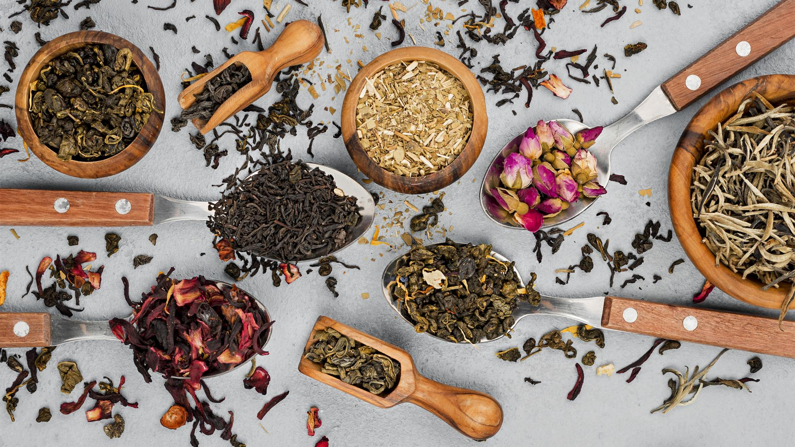

.
Your Favourite Cup of
Instant Food & Beverages... Any time, Anywhere

Slide 2


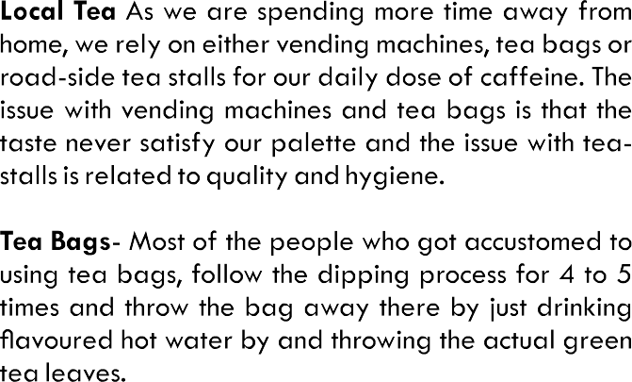
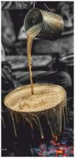
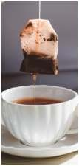
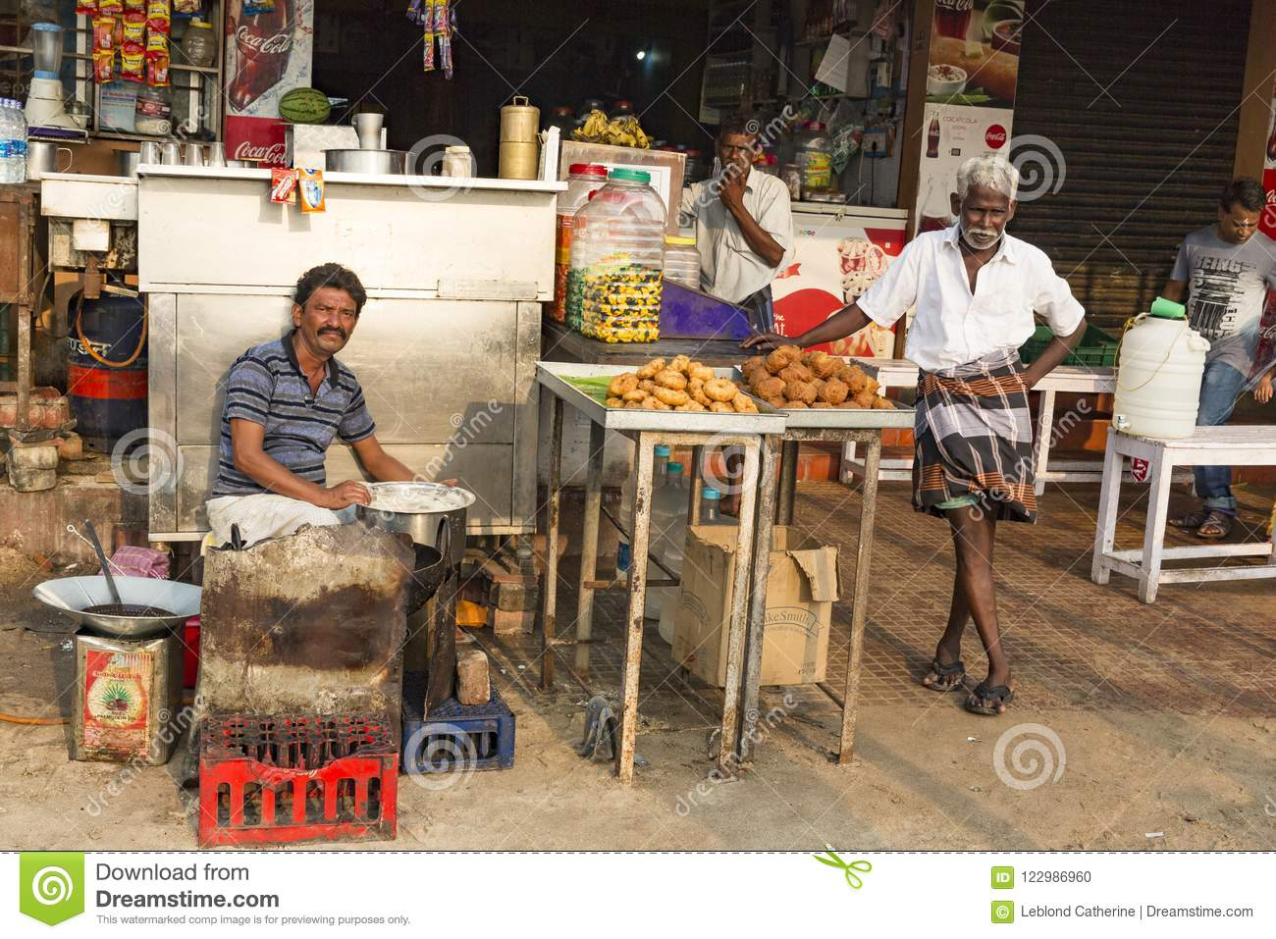
Problem
1
2
3

Slide 3
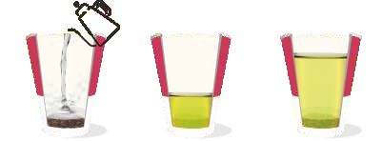

OUR SOLUTION
OneCup Concept-1 ( Layer )
OneCup Concept-2 ( Foil tagger )

Slide 4
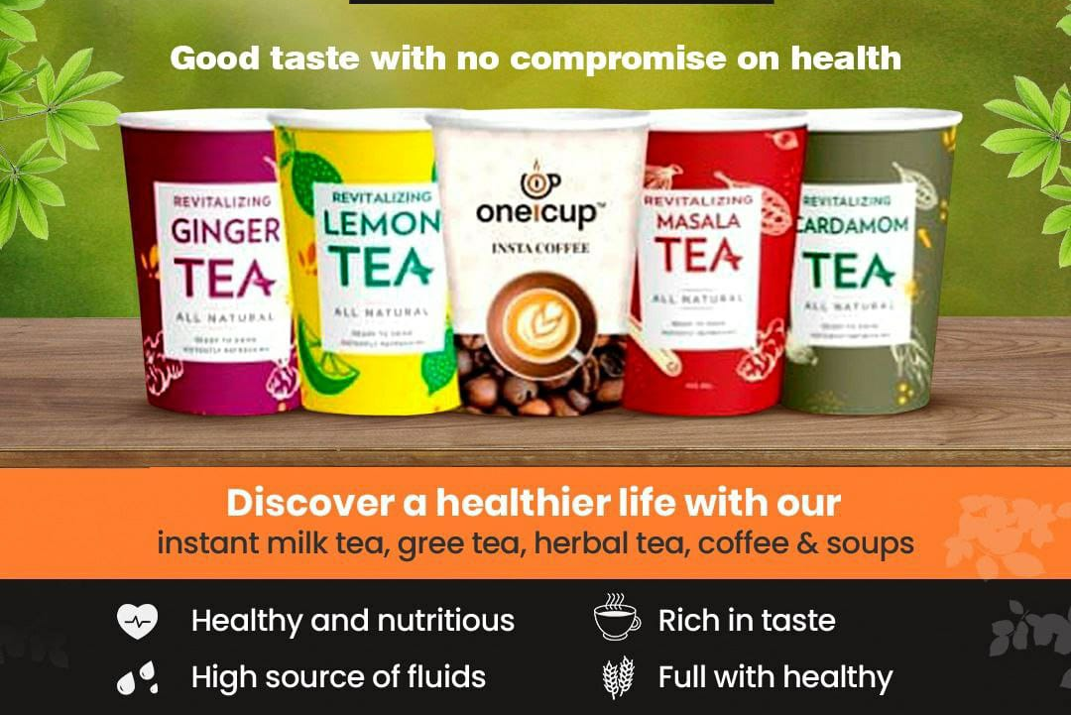
UNIQUE SELLING POINT
EASY TO USE WITH
TIME SAVING
ANYTIME & ANYWHERE WITH CHOICE
COMPETITIVE PRICE WITH QUALITY
UNIQUE HYGIENIC CONCEPT
Kholo Gholo Peelo

Slide 5





TEA- COFFEE
Flavoured Tea/ Coffee beverages with the mixture of 100% natural ingredients of aromatic spices & herbs. OneCup Instant Tea is ready - made and “On the Go” cup robust local tea. Anywhere and Anytime can now have Ghar - Jaisi - Masala Chai by just adding Hot water in ONECUP Instant cup.
110ml
Avalable in No Suger Also

Slide 6
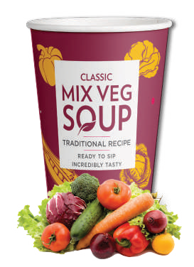
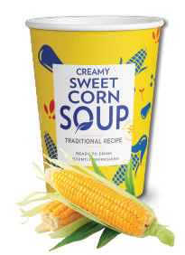

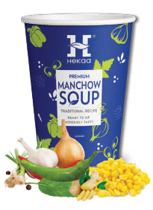
SOUP
A thick, creamy and hearty concoction with a gentle warming heat. Savour the delectable bites of real broccoli, sweet corn and green peas with each sip. It is made from 100% vegetables and no added preservatives and NIL MSG. The secret of ONECUP is that the variety suit every taste palate in a country with diverse tastes. It is full of natural calories, vitamins and nutrients which keeps you healthy and ﬁt. It boost up your taste buds with its appetizing taste and keeps you energize all the day.
150 ml

Slide 7










WELLNESS TEA
Wellness tea is the healthiest beverage on the planet. It is loaded with antioxidants and nutrients that have powerful eﬀects on the body. These include improved brain function, fat loss, a lower risk of cancer and many other impressive beneﬁts
110 ml , can be used
2 times

Slide 8
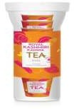


PACKAGING
Wellness Tea
Tea / Coffee/ Soup
12 Cup in Pet Jar
6 Cup in Food Grade Alu Pouch
ALL CUPS ARE MADE WITH ITC FOOD GRADE PAPER

Slide 9



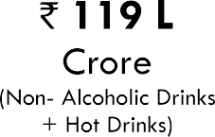
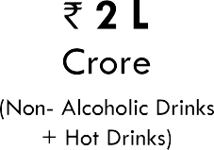



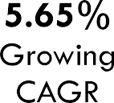
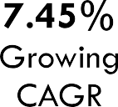


Slide 10

BUSINESS MODEL
B2B
B2B2C
CUP AD

Slide 11
3,00,000 cups
TRACTION
SOFT launched on 1st April 2022

Slide 12
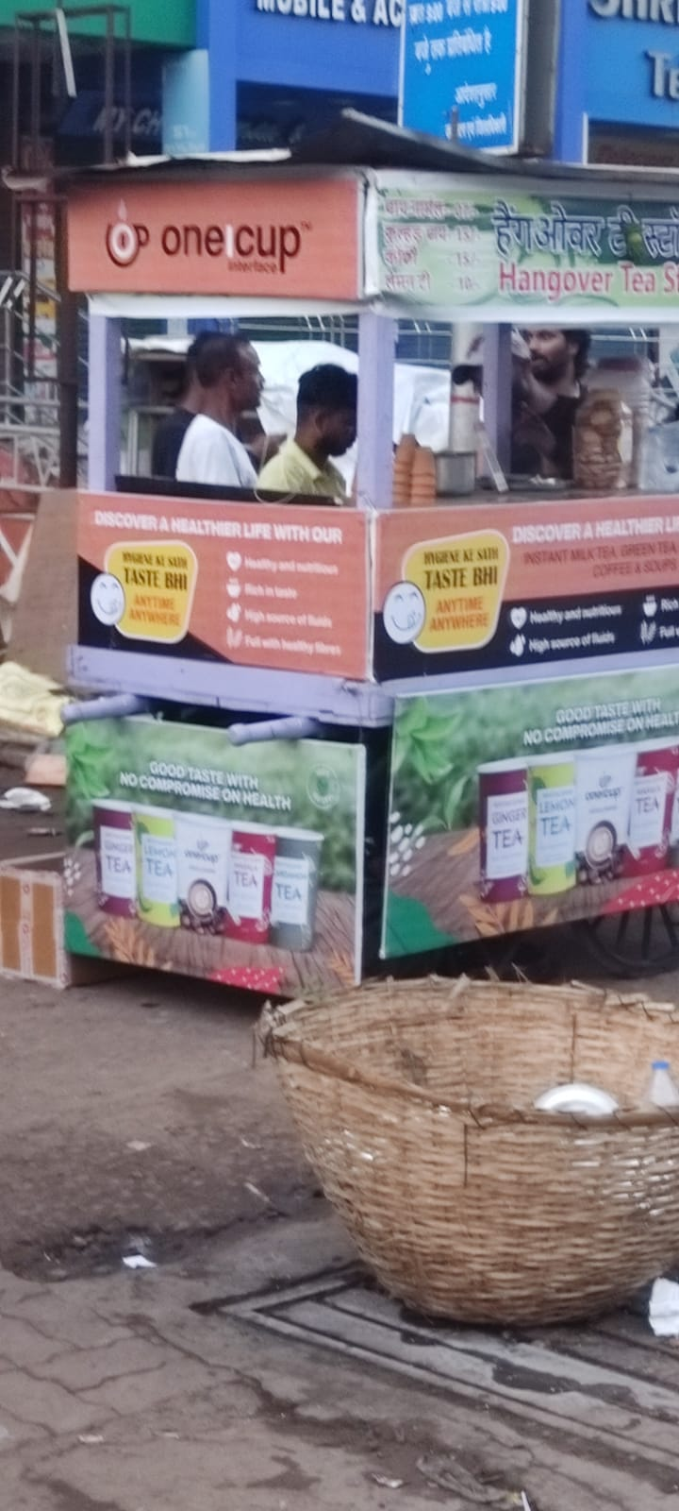
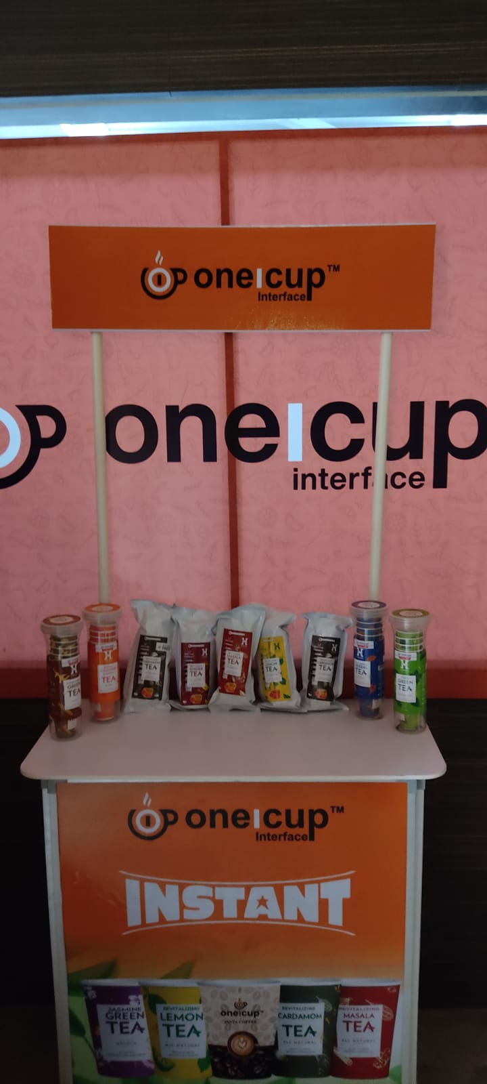
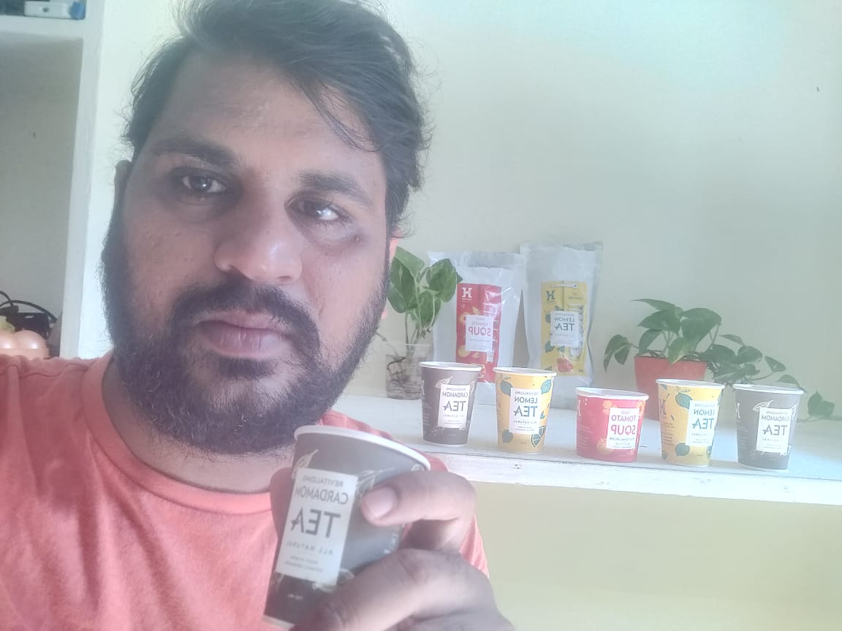

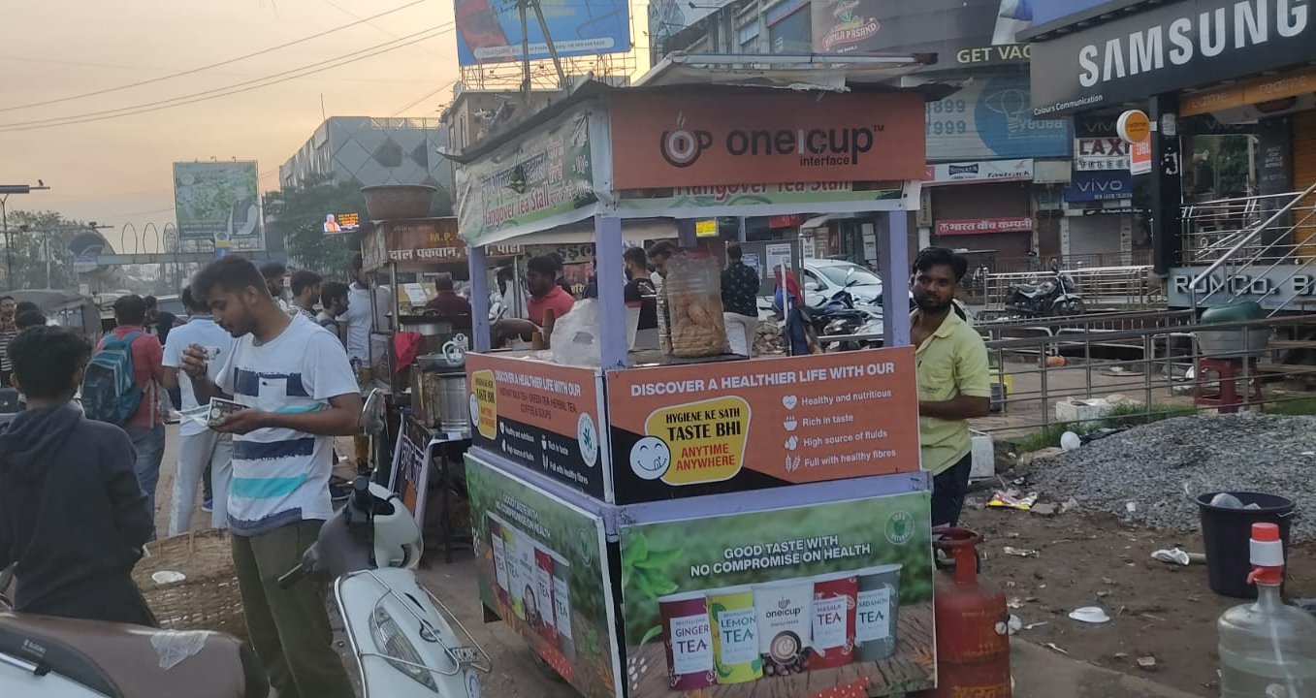
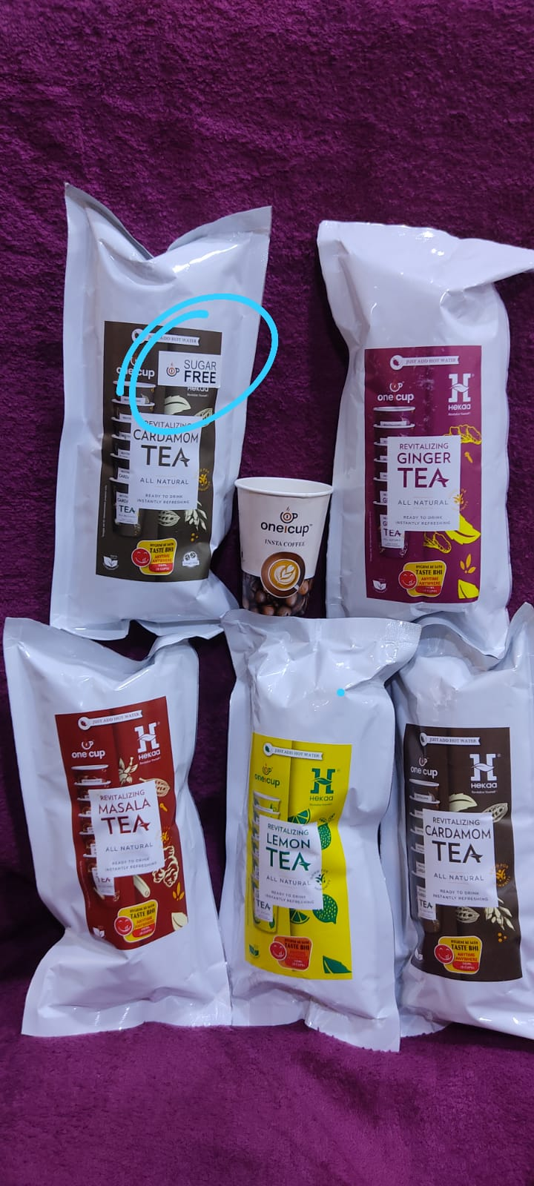

Slide 13
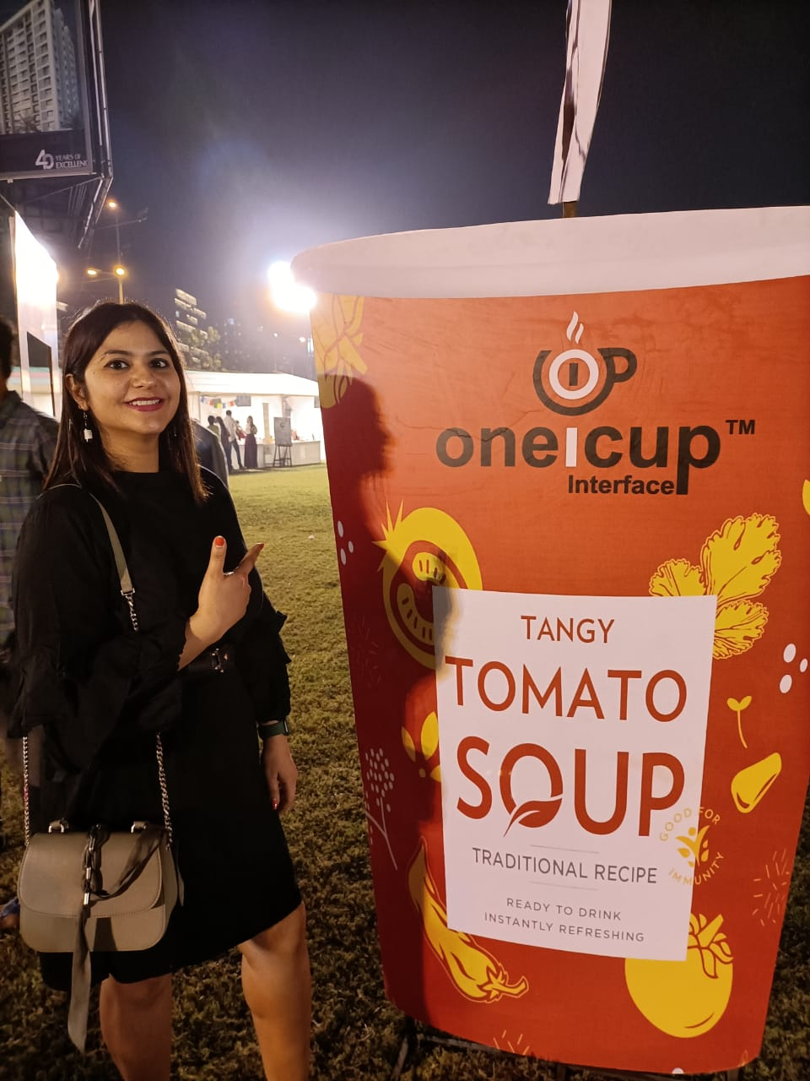
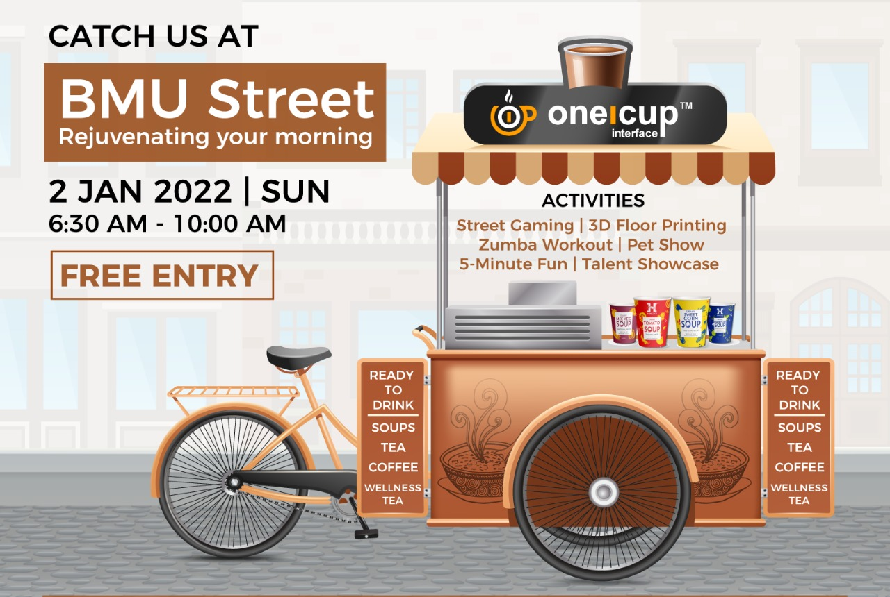
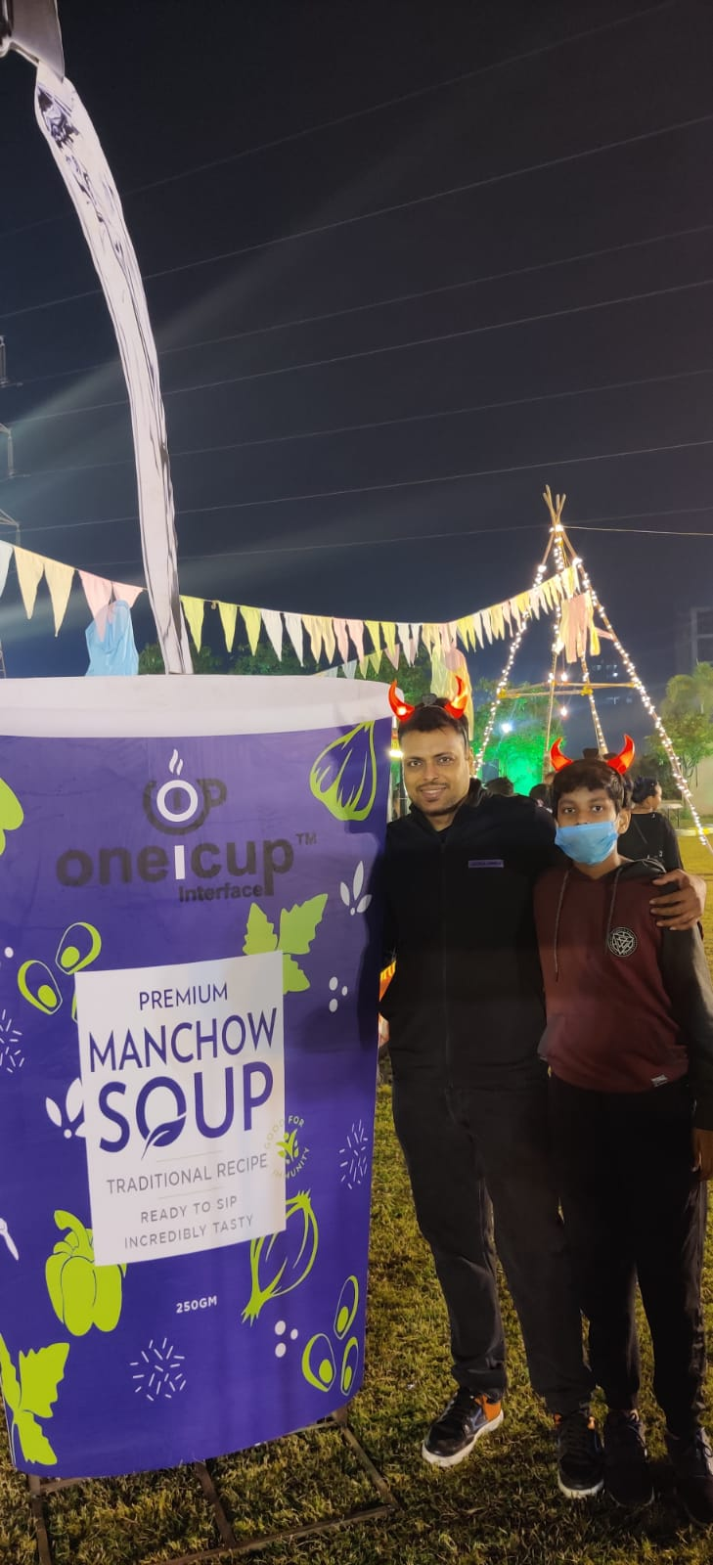
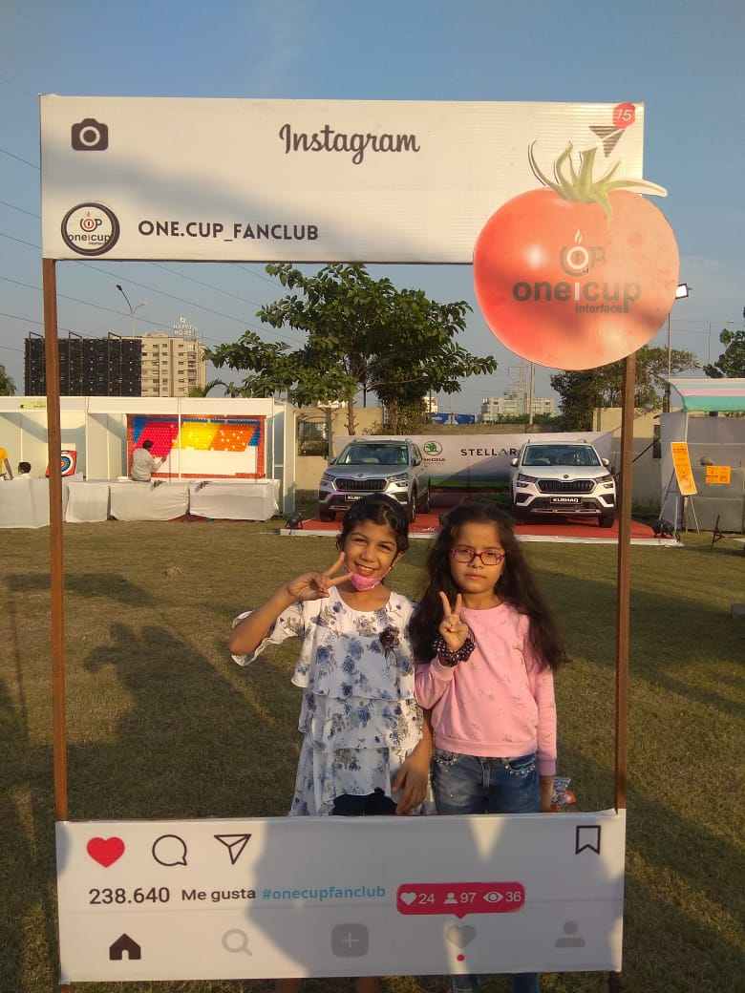

Slide 14
TARGET CUSTOMERS
Small offices
Standalone shops
Showroom
Salons
Etc……..
Ola/ Uber
Bus operators
Tour operators
IRCTC
Shopping Malls
Pan shop
Petrol Pump
Hospital
Hostel
Fast food outlet
All outlet were cold drinks are available
10
Cup a day
A Husband who wanted to make a Cup of Tea or Coffee for his wife……

Slide 15
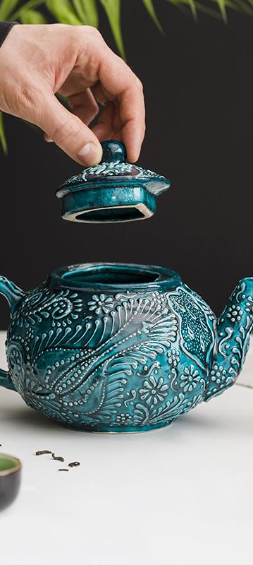
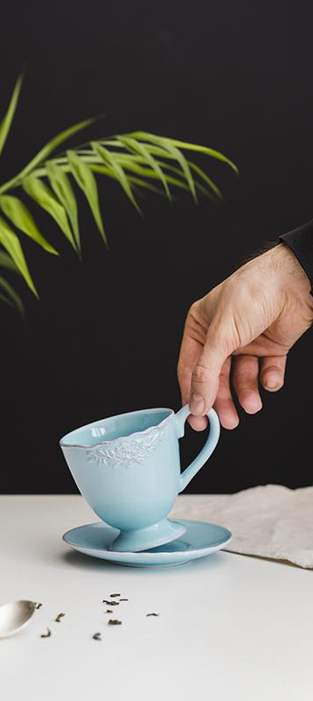
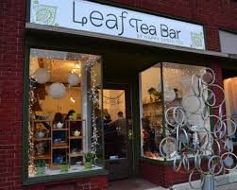
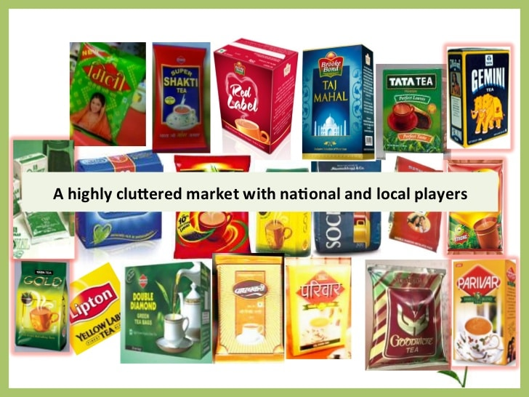

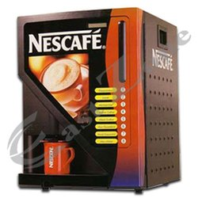
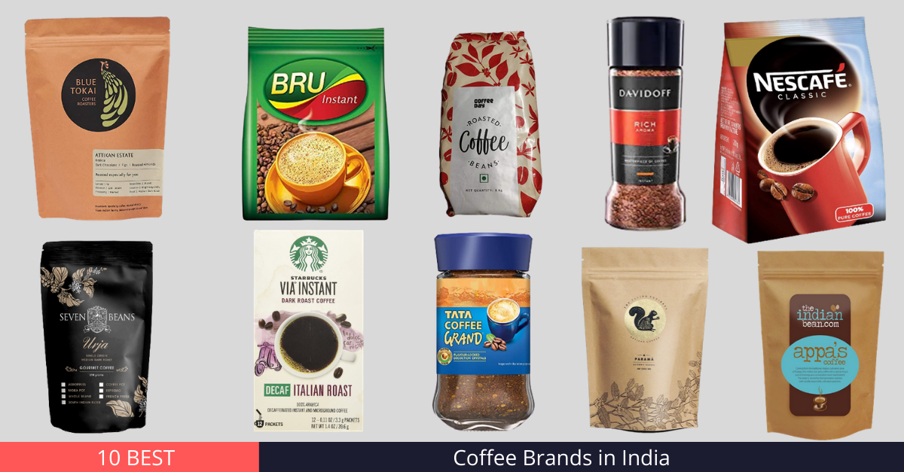
COMPETITORS
DIRECT INDIRECT

Slide 16
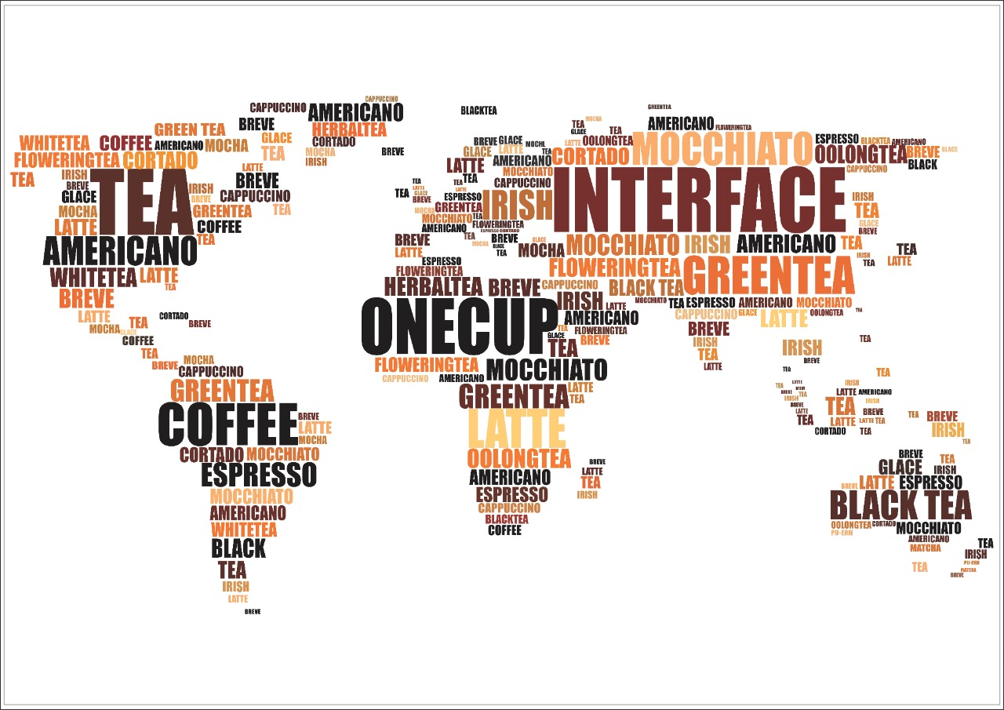

Future Strategy & Roadmap
Step 1
1
9 CITY – 2000 CUP/DAY
Q2 2023
Step 2
2
18 CITY – 2000 CUP/DAY
Q3 2023
Step 3
3
40 CITY – 2000 CUP/DAY/ CITY
Q4 2023
Step 4
50 CITY – 100000 CUP/DAY
4
Q1 2024

Slide 17
1,00,000
TARGET
1,00,000
Cups Per day till
Dec 2023
Subscription till
Dec 2025

Slide 18
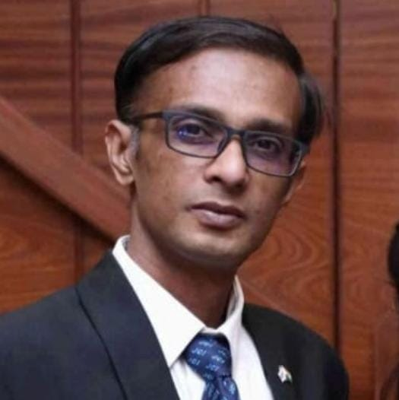
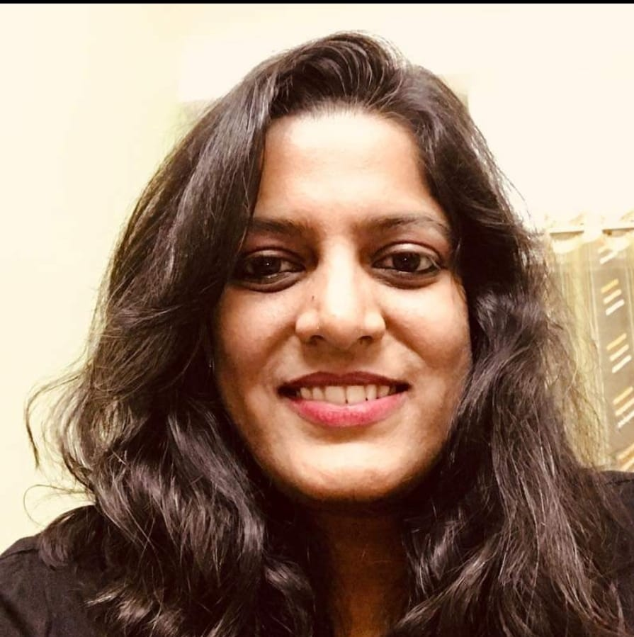
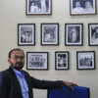
OUR TEAM
DEVESH PATEL
SARASWATI SWAMI
DILIP KUMAR
FOUNDER –ONECUP INTERFACE
IIMM,
15+ Years Exp in Sales and Distribution FMCG, PHARMA,F&B TELECOM
HEAD – AD DIV.
MICA,
15 Years Exp IN MEDIA
TOI, HIMALAYA
HEAD – PRODUCT
9 Year in Product Development .

Slide 19
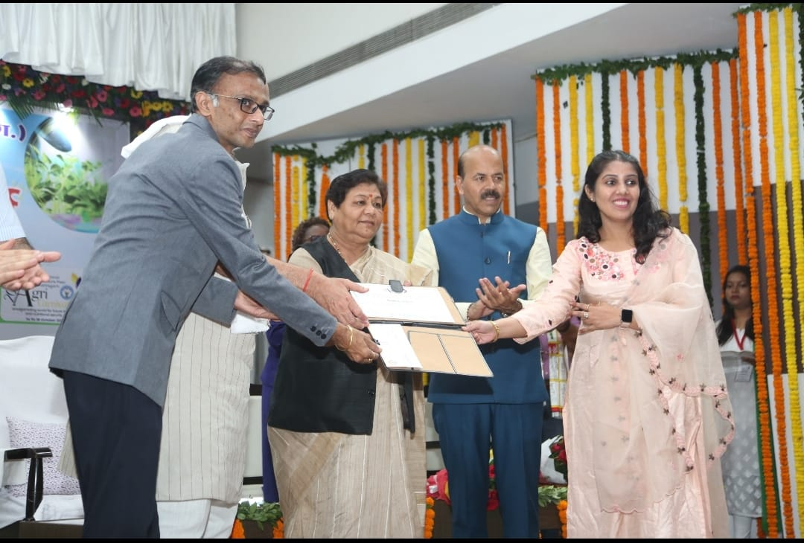
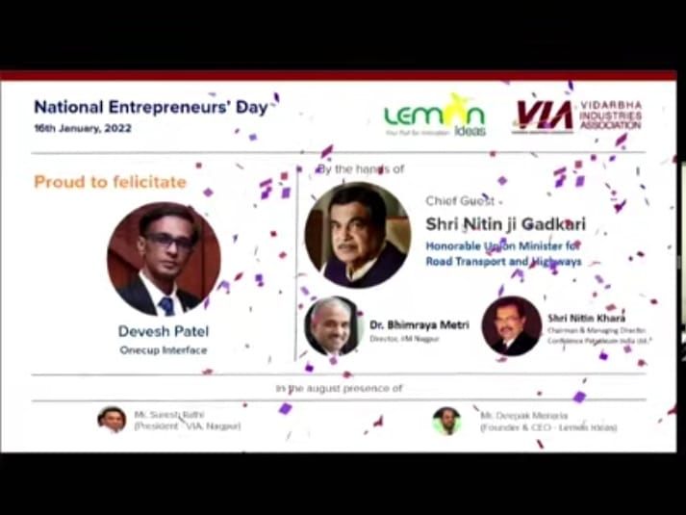







AWARDS

Slide 20
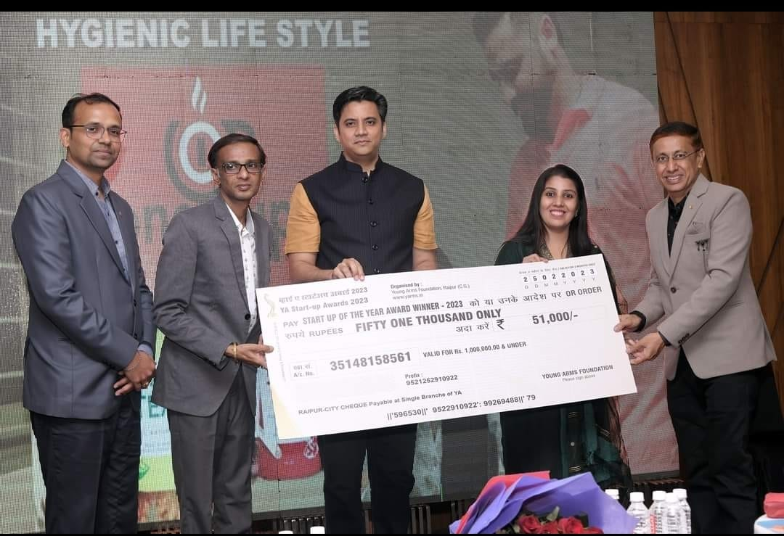
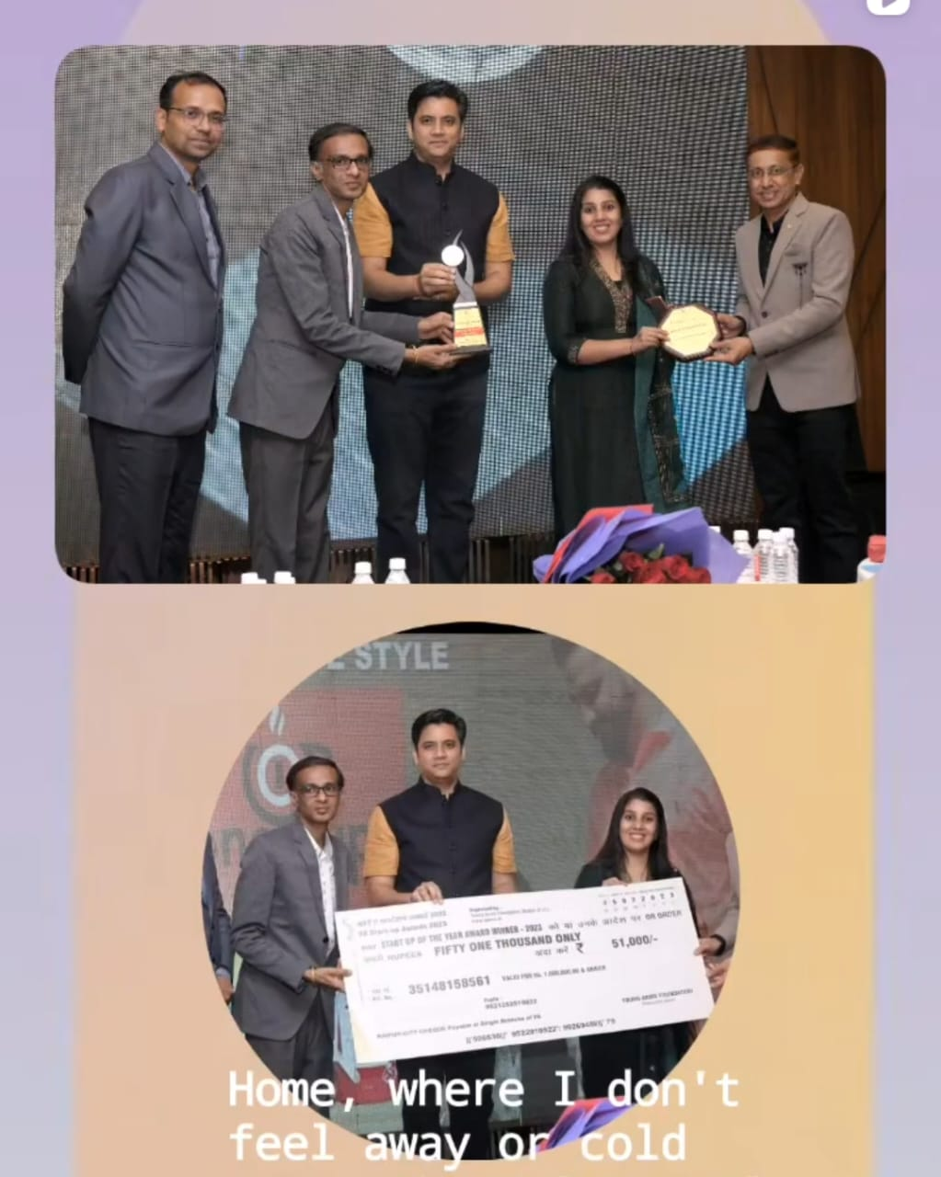

Slide 21
https://www.linkedin.com/in/deveshindia/

Slide 22
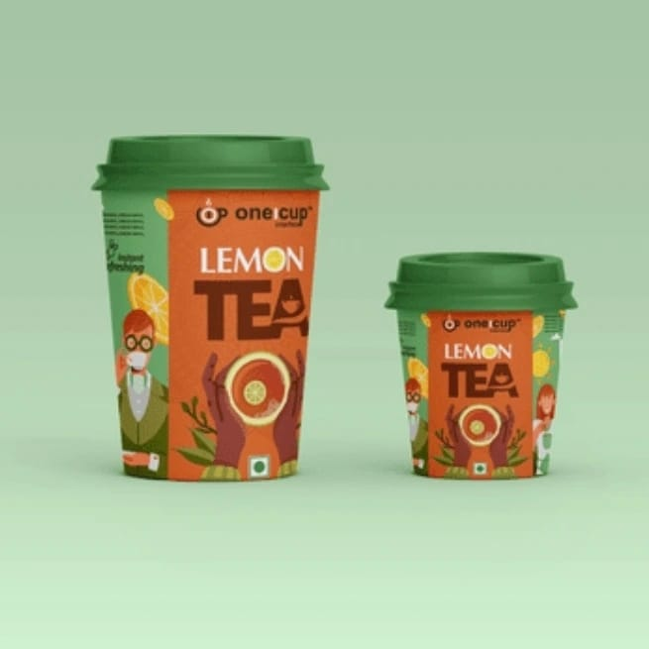

Slide 23



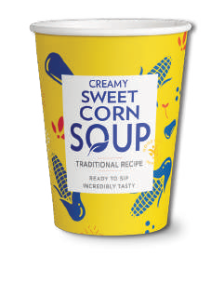
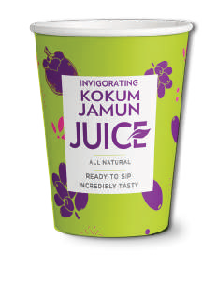
PRODUCTS OVERVIEW

Slide 24
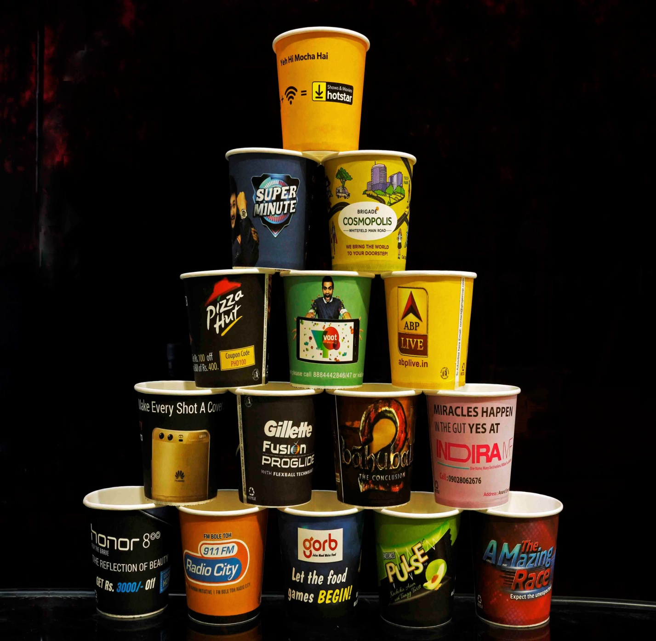
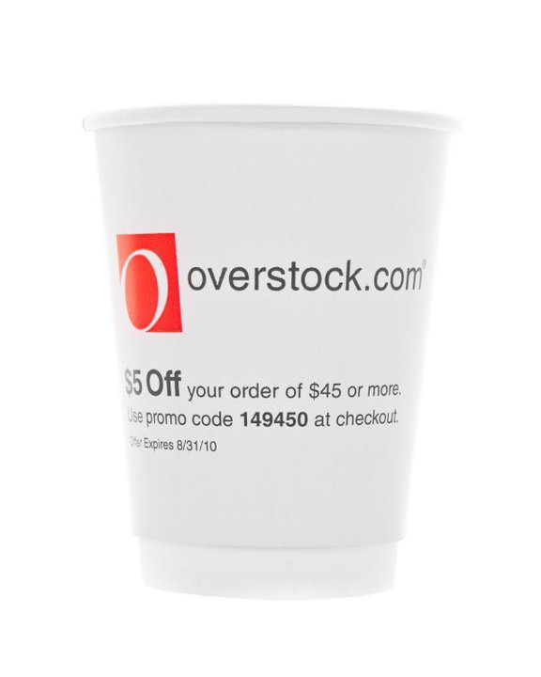
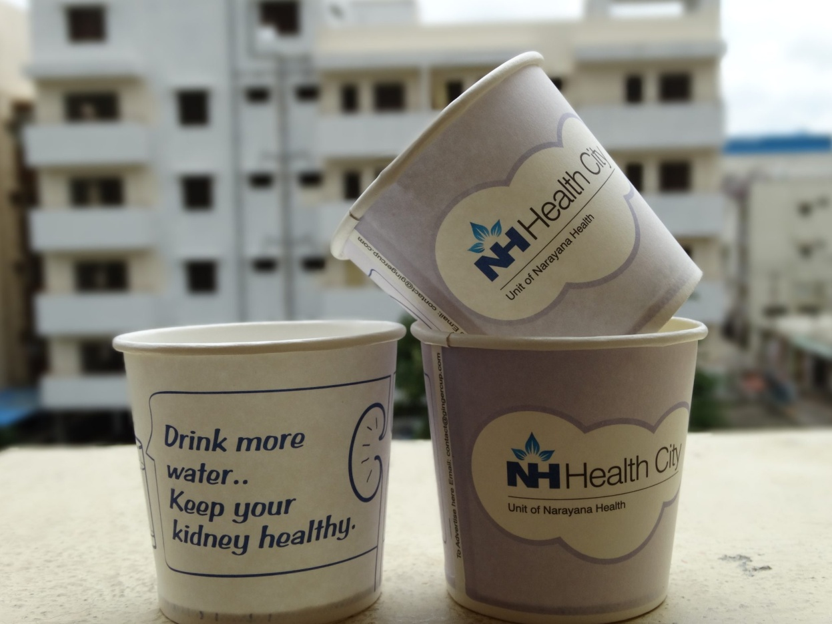
CUP AD DIV. OVERVIEW

Slide 25
